Slide 1
Creating & Sharing Value with Network Activity & Threat Correlation
Jamison M. Day, Ph.D.
Distinguished Data Scientist

Slide 2
Overview
Network Activity & Threat Correlation
Creating Value Within Your Organization
Sharing Value Between Organizations
When Does Information Sharing Work?
Why Doesn’t Information Sharing Work?
Potential Directions for Improvement

Slide 3
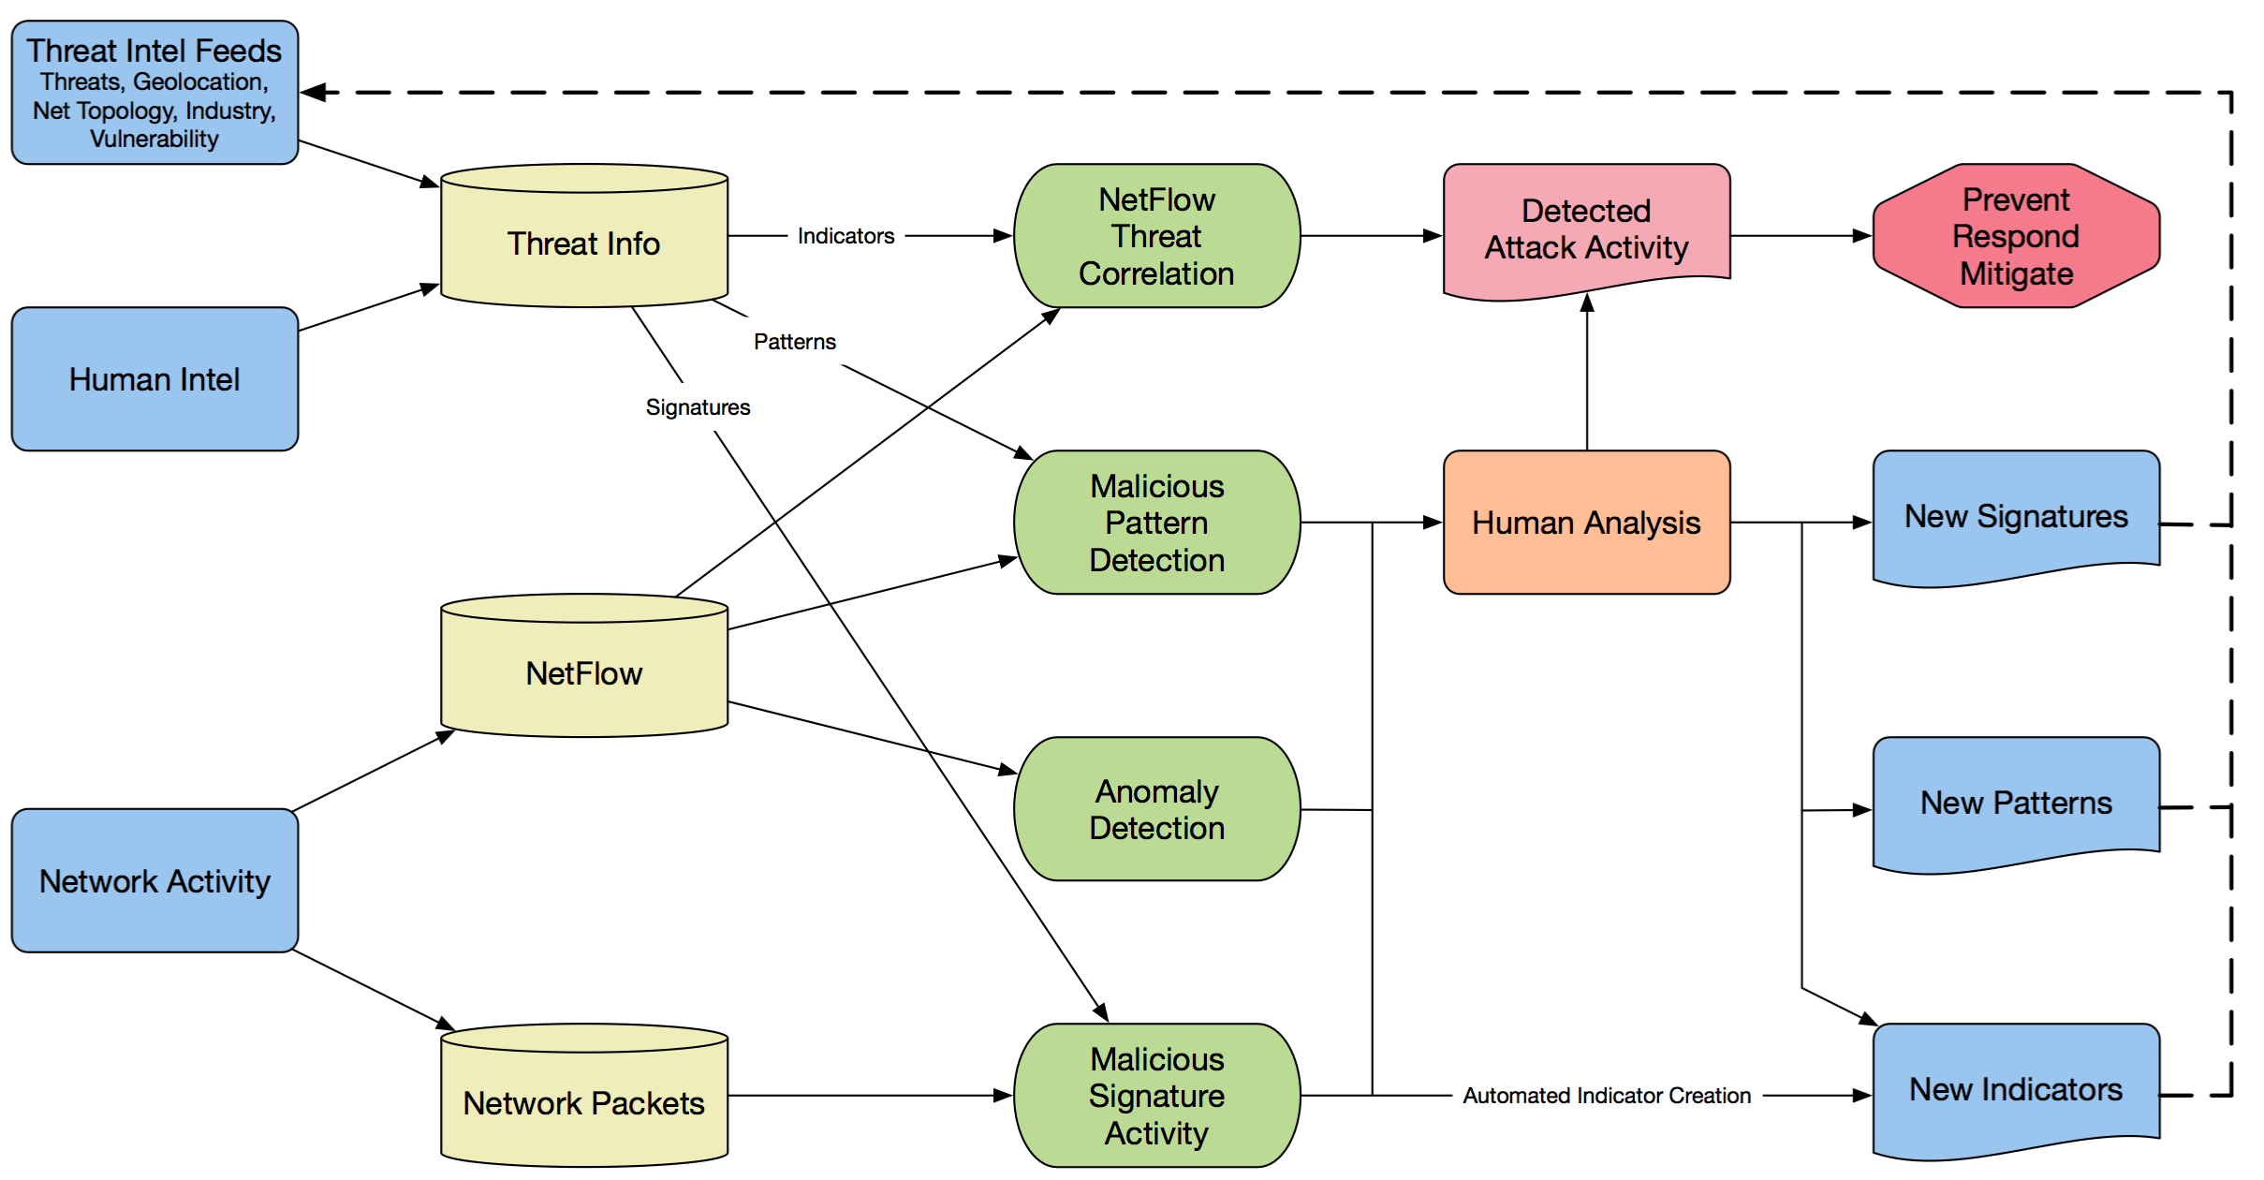
Creating Value: Continuous Improvement Cycle

Slide 4
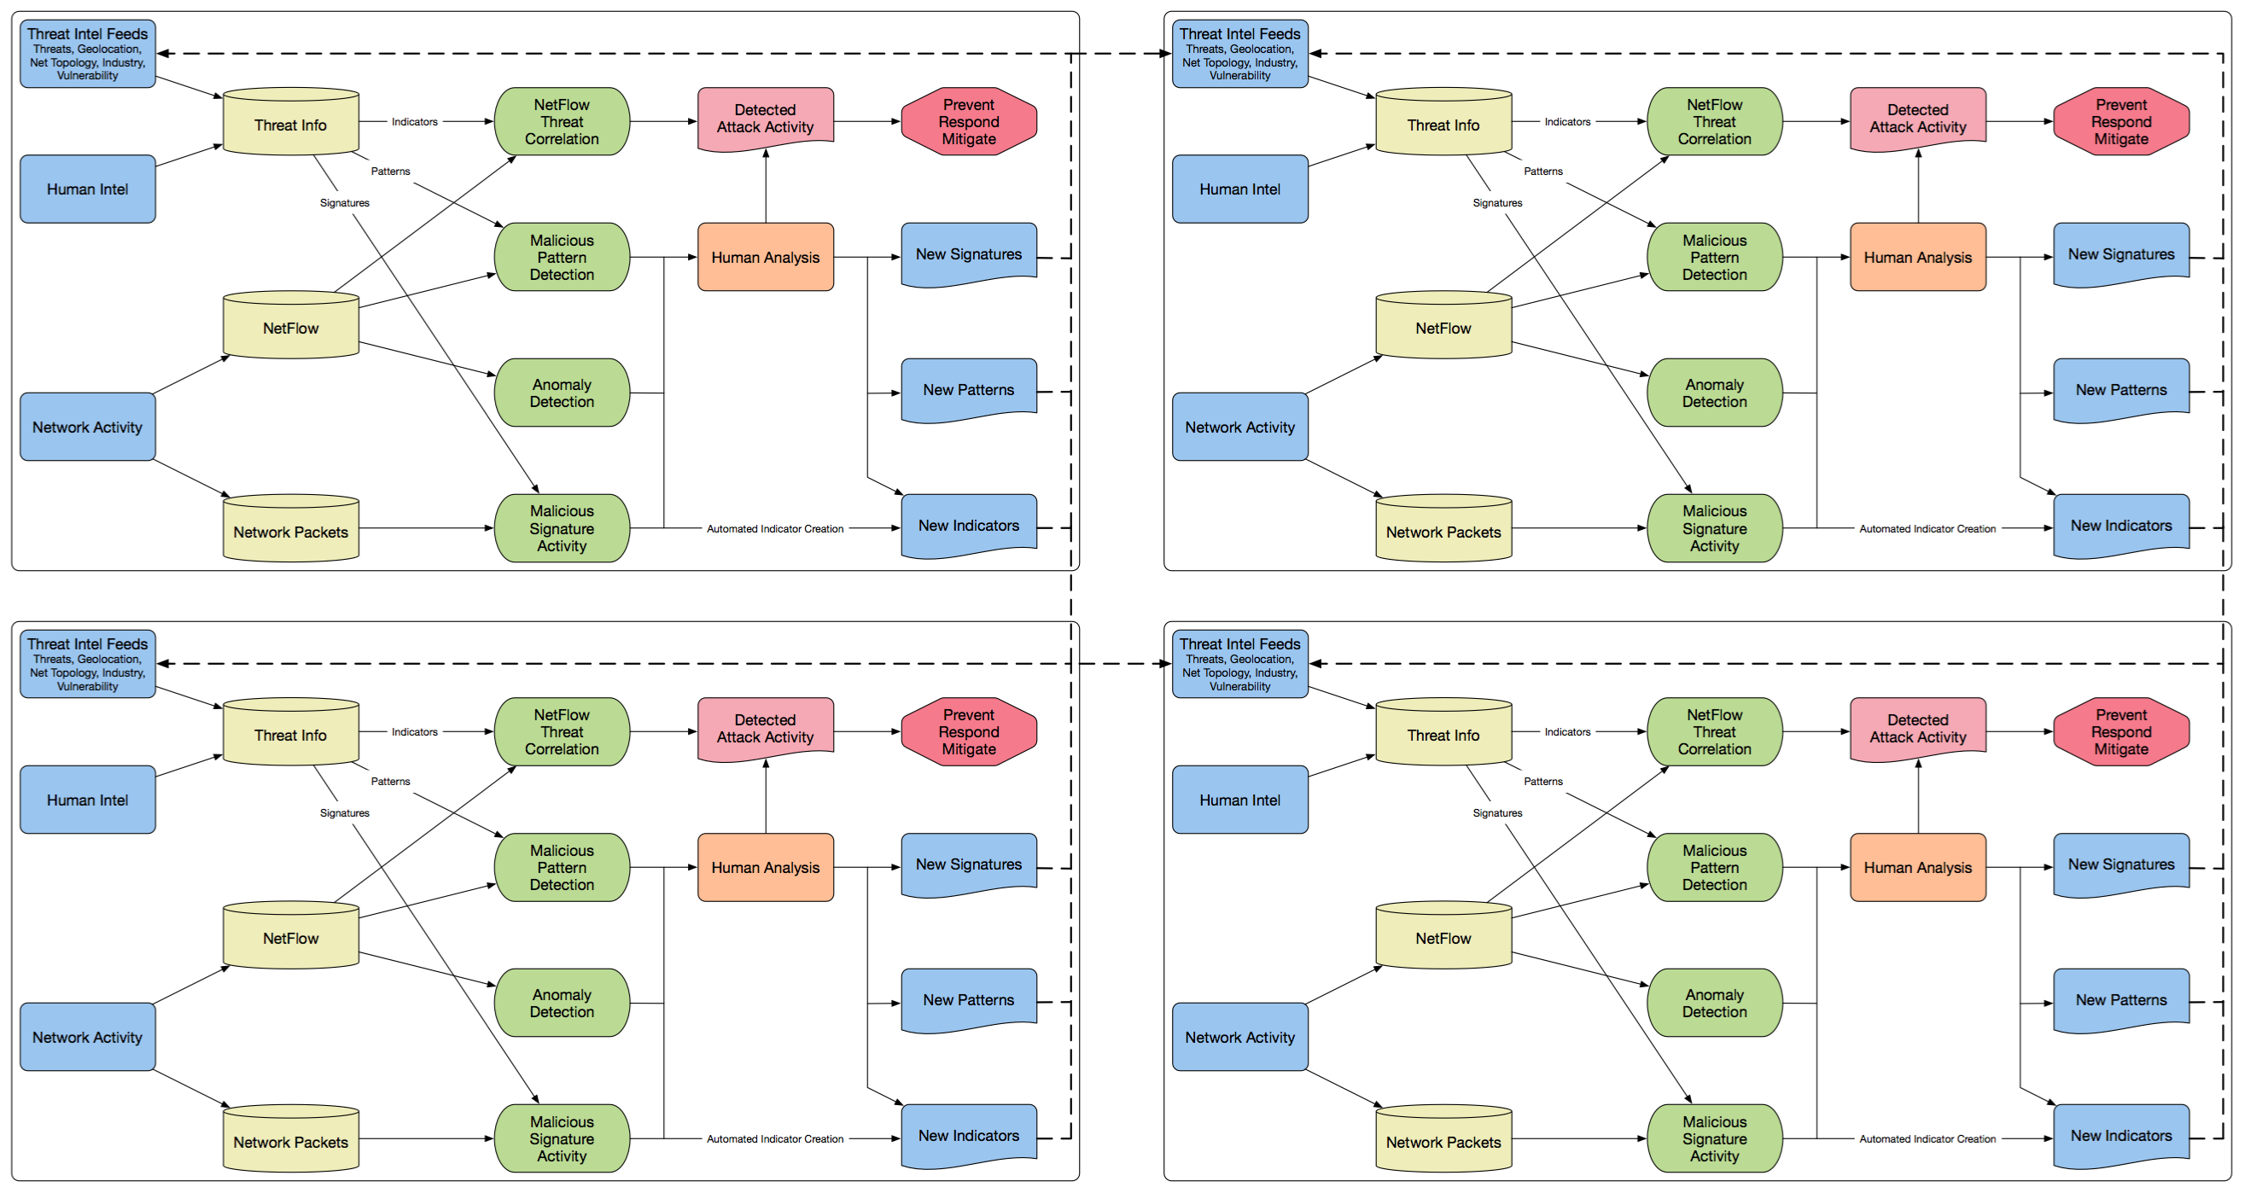
Sharing Value: Threat Information
Sharing NetFlow or PCAP data is not necessary.

Slide 5



Some Threat Information Sharing Model Examples
Public Sector
DHS Cyber Information Sharing AIS & CISCP
(https://www.dhs.gov/ais)
(https://www.dhs.gov/ciscp)
Critical Infrastructure
FS-ISAC
(https://www.fsisac.com/)
General Private Sector Sharing
Cyber Threat Alliance (CTA)
(https://www.cyberthreatalliance.org/)

Slide 6
When Does Information Sharing Work?
Cyber Security & Tragedy of the Commons
Industry-Wide vs. Individual Company Concern
How much focus is on the pie vs. the slice?
How might sharing threat information affect a company’s competitive advantage?
How does the compromise of one company affect an entire industry?
Consider Financial & Critical Infrastructure vs. Retail & Manufacturing
Regulatory Control
Joint Visibility in Customer Trust/Confidence
?

Slide 7
Why Doesn’t Information Sharing Work?
Collection
Inconsistent
Data/Formats
Inadequate
Stream
Unreliability
Inaccessibility
Low Priority
Cyber Threat
Detection
Processing
Source
Identification
Storage Media
Misalignment
Unwillingness
Sharing
Day, Jamison M.; Junglas, Iris; and Silva, Leiser (2009) "Information Flow Impediments in Disaster Relief Supply Chains," Journal of the Association for Information Systems: Vol. 10 : Iss. 8 , Article 1.

Slide 8
Information Flow Impediments
Inaccessibility
Can’t obtain data known to exist
Source Identification
Not knowing where to obtain data
Low Priority
Data is not important enough to collect, process, share
Storage Media Misalignment
Data storage method does not support desired information activities
Inconsistent Data Formats
Different data configurations limit comparison or aggregation
Inadequate Stream
Too much or too little information
Unreliability
Low confidence in data content
Unwillingness
Refusal to transmit data to others

Slide 9
The Tough Issue: “Unwillingness”
Value Creation: Hoarding knowledge to maintain competitive advantage
Cyber investments shouldn’t help competitors / should be compensated
Takes additional energy/investment to effectively share information
Trust: Lack of confidence in a partner or community to treat your information as desired
Attribution or anonymity
Distribution restrictions
Augmentation or modification
Privacy: Information content infringes on others rights or puts others at risk
Personally Identifiable Information (PII)
Organization affiliation or association
Legal: Regulatory restrictions or legal liabilities related to sharing the information
International sharing limitations
Potential legal retaliation (note: no civil/criminal cases with negative impact on TI sharer… yet)

Slide 10
2015 Cybersecurity Information Sharing Act (CISA)
Addresses Some Legal & Privacy Issues
(https://en.wikipedia.org/wiki/Cybersecurity_Information_Sharing_Act)
Liability Protection
Provides liability protection from lawsuits for a private sector entity that is sharing or receiving cyber threat indicators.
Guidelines for Treatment of Personally Identifiable Information
Remove PII not directly related to cyber security threat.
Industry to Government Privacy Protections
Ensures guidelines exist for the receipt, retention, use, and dissemination of cyber threat indicators by a federal entity obtained when cyber threat indicators are shared with the federal government.

Slide 11
Potential Directions for Improved Information Sharing
Legal & Privacy: Maintain Control Over Shared Info
Data Centric Security (https://en.wikipedia.org/wiki/Data-centric_security)
Secure the data itself rather than computers, networks, and applications
Post-Distribution Access Control
Audit Requests, Access, & Denial
Value Creation: Compensate for Information Value
Smart Contracts (https://en.wikipedia.org/wiki/Smart_contract)
Low transaction cost, self-executing, self-enforcing
Use of Information Transfers Value
Trust: Create Sharing Communities
Social Reputation Feedback Mechanism

Slide 12




Thank You
www.lookingglasscyber.com
/LG_Cyber
/LookingGlassCyber
/company/LookingGlass
/+LookingGlassCyber

Slide 13
We’ve Got AV Protection & Firewall. We’re SAFE, Right?!?
43% of attacks come from phishing
(https://healthitsecurity.com/news/verizon-finds-phishing-attacks-malware-top-data-breach-causes)
Hoping for good decisions by humans
Need threat intel gateway to supplement firewall
Up to 63% of attacks originate in the supply chain
(http://go.soha.io/hubfs/Survey_Reports/Soha_Systems_Third_Party_Advisory_Group_2016_IT_Survey_Report.pdf?t=1467123126371)
Need 3rd party monitoring
System patching issues
Applying newest patch crashes our systems! Test and deploy process requires time.
Need Patch Camouflage

